Slide 1
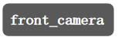
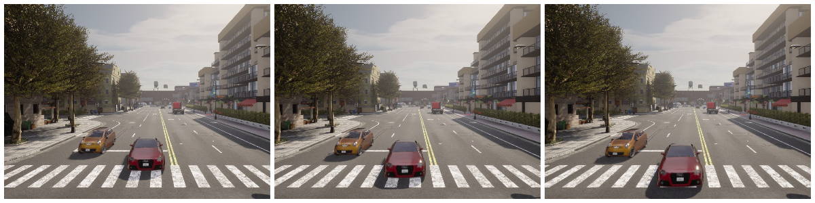
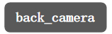
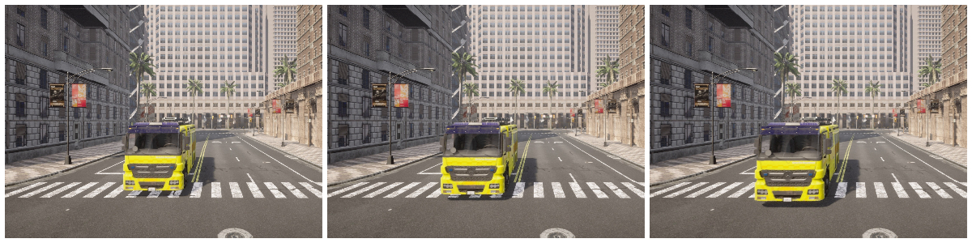
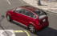
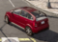

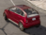
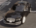
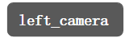
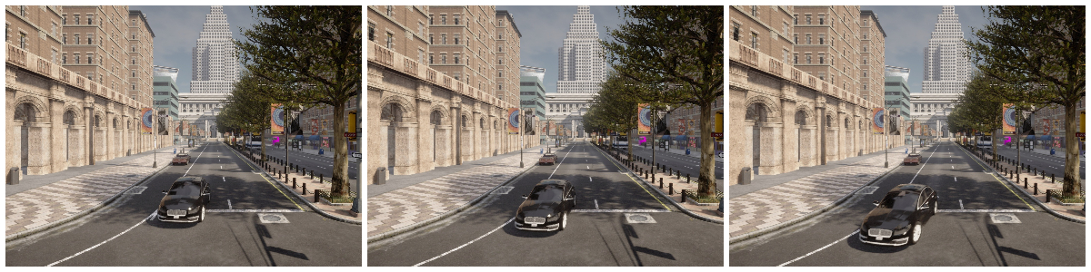
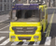
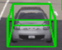
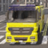
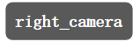
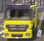
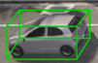
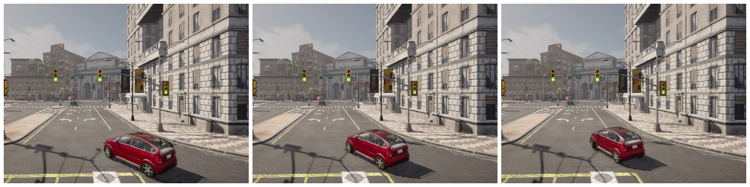
front_camera
back_camera
left_camera
right_camera
·
·
·

Slide 2
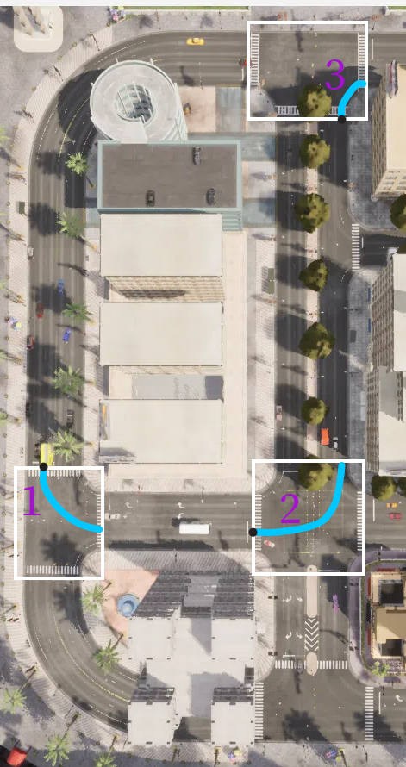
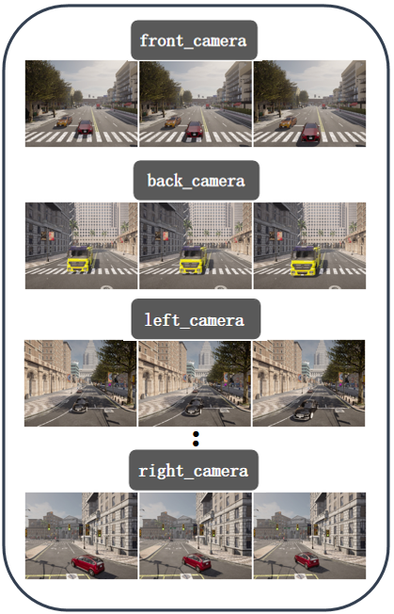
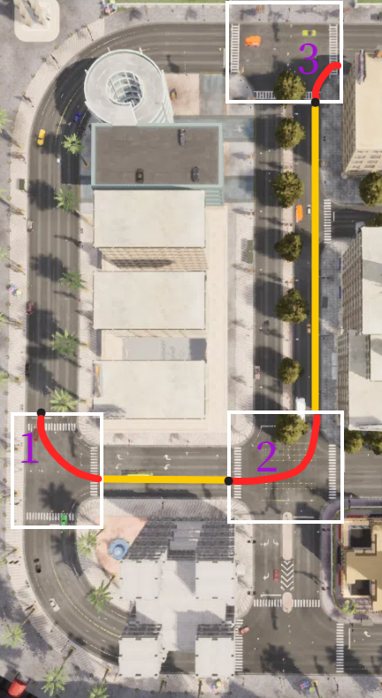
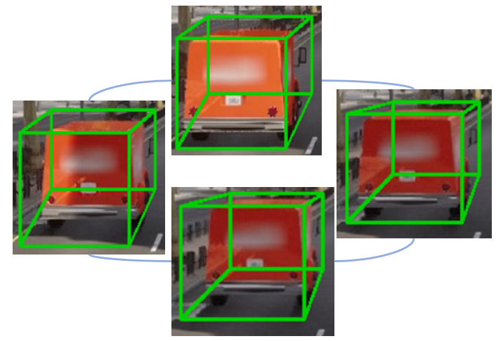

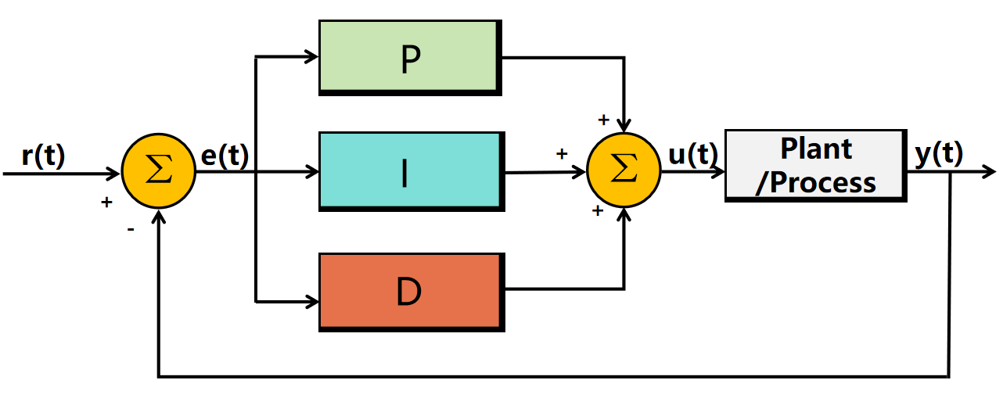
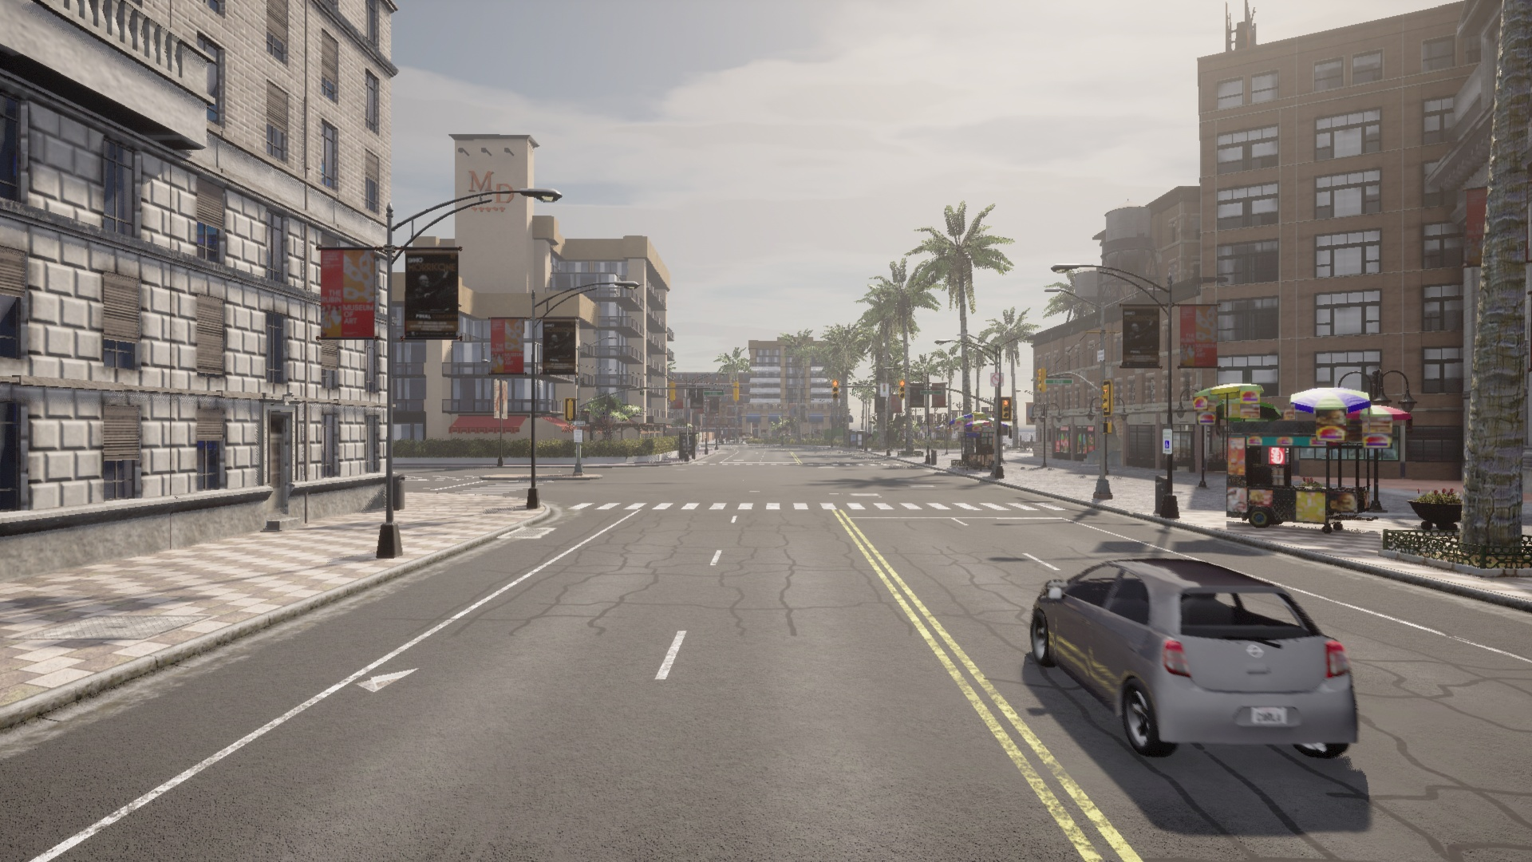
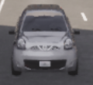
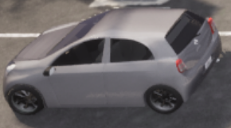
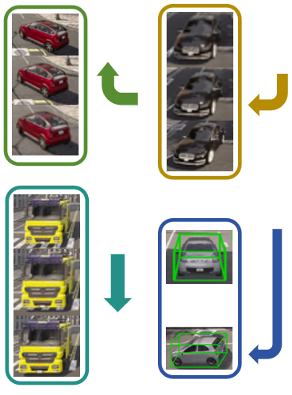
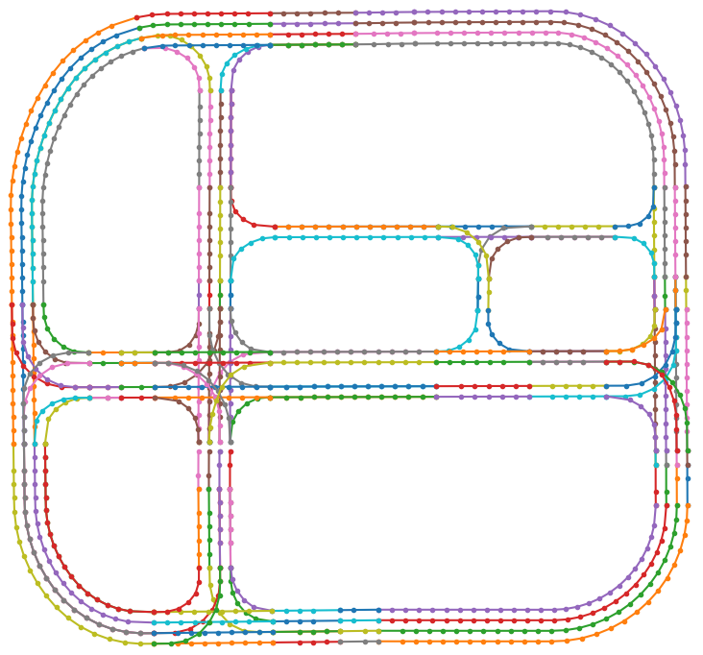
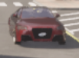
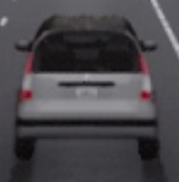
Object Detection
+0.5
+0.7
Trajectory Smoothing
PID Controller
YOLO v4
+1.1
+1.3
Trajectory Sequence
pointPillars
TrackerJPDA
Multi-Object Tracking
Navigation Algorithm
Vehicle Model
Feature Extraction
Calculating Similarity
Trajectory Matching
Topology Map
Twin Trajectory
Re-ID Net
Trajectory Prediction
Vehicle Control
Re-identification

Slide 3
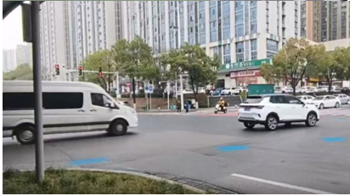
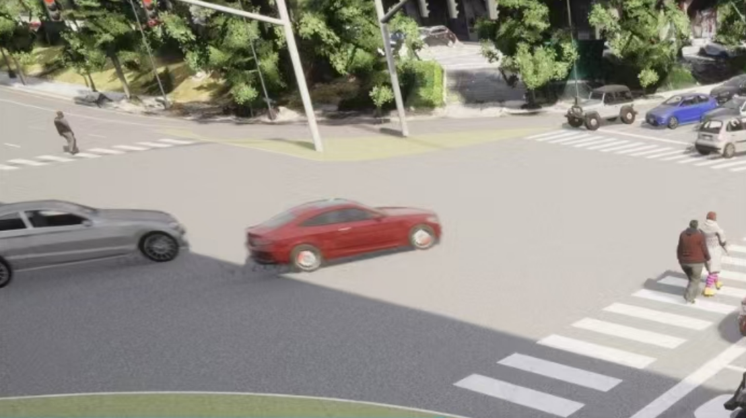
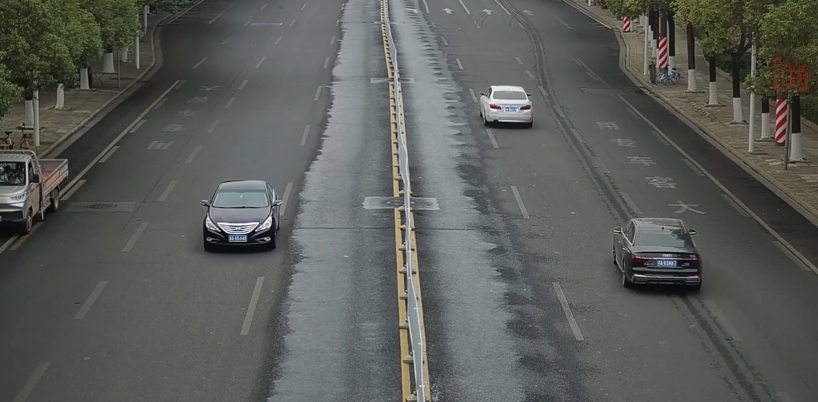
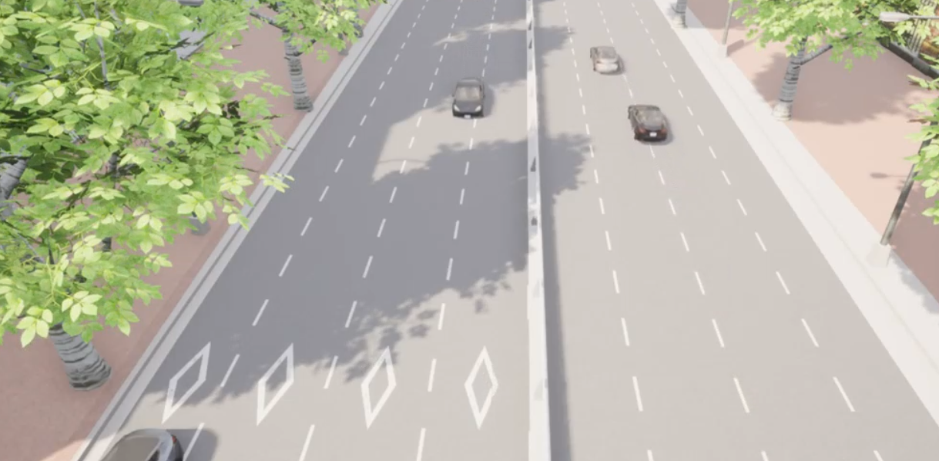

Slide 4
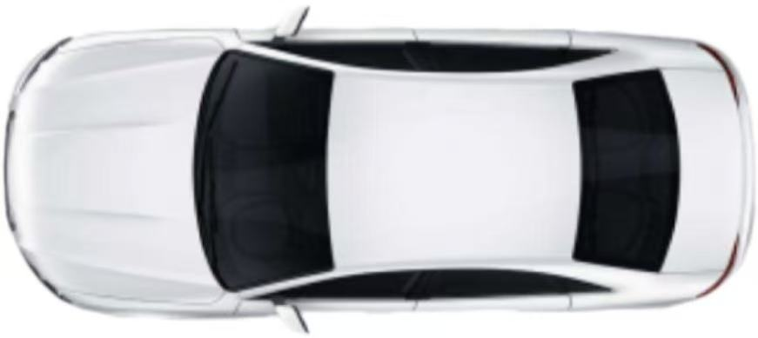
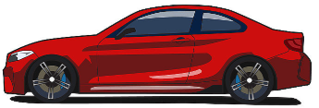
Upward
X-axis
Y-axis
Left-Camera(2.62m)
Z-axis
Front-Left-Camera(2.62m)
4m
4m
Front-Camera(2.62m)
7m
LiDAR(0.82m)
Back-Camera(2.62m)
7m
4m
4m
Right-Camera(2.62m)
Front-Right-Camera(2.62m)
(a) Sensor placement
Ego-vehicle Coordinate System
LiDAR Coordinate System
Transformation matrix
JPDA
0.82m
P₂(x₂,y₂,z₂)
O(0,0,0)
P(x₀,y₀,z₀)
P₁(x₁,y₁,z₁)
(b) Coordinate transformation

Slide 5
Intersection R₁
Trajectory T₁
Intersection R₂
Trajectory T₂
Intersection R₃
Trajectory T₃
P₁(t_{1_end})
P₂(t_{2_start})
NAVIGATION ALGORITHM FRAMEWORK
Topological Map Input
Start/Goal Input
A* Algorithm
Trajectory Interpolation
C₁: P₁->P₂
Position Identification
Feasibility Check
Yes
Trajectory Generation
No
Lane Change Strategy
C₂: P₂->P₃
Exception
Termination
Time Axis t:
T₁
>>>>>C₁>>>>>
T₂
>>>>>C₂>>>>>
T₃

Slide 6
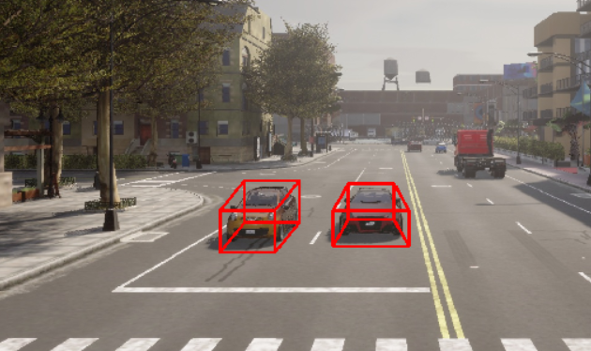
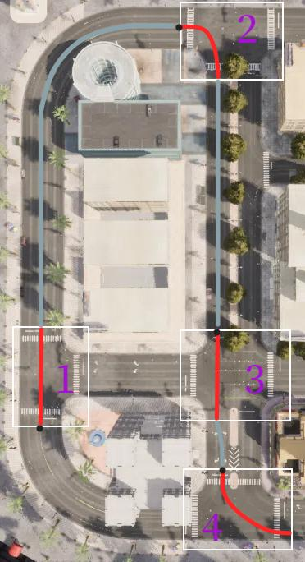
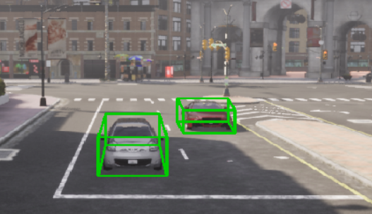
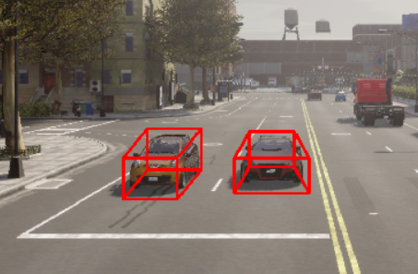
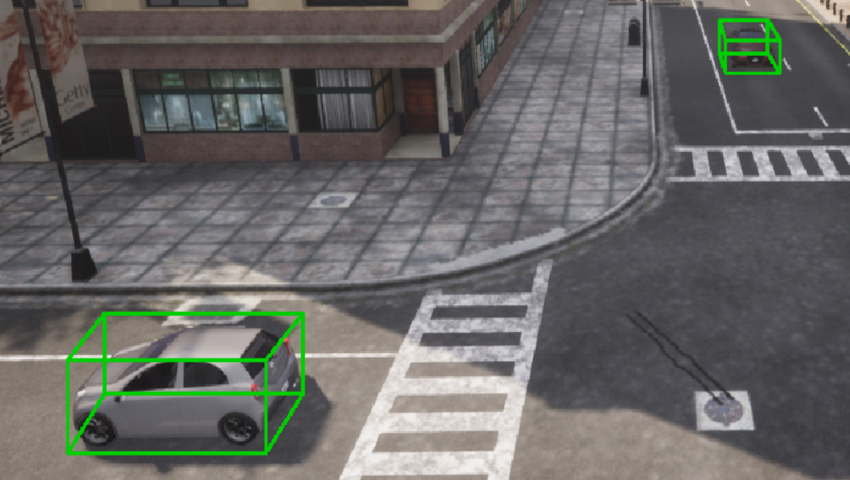

Slide 7
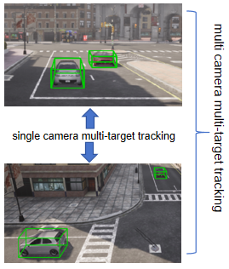
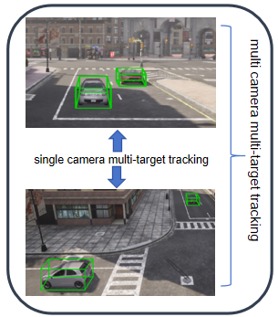
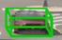
multi camera multi-target tracking
single camera multi-target tracking

Slide 8
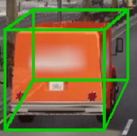
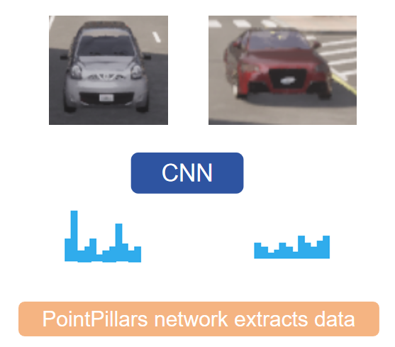
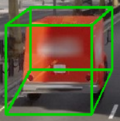
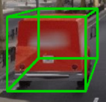
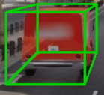
CNN
PointPillars network extracts data

Slide 9
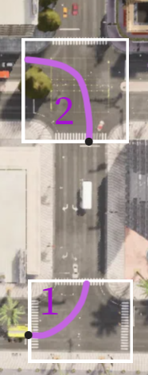
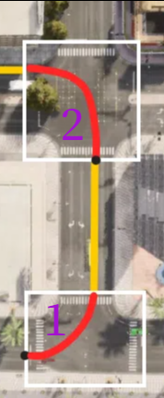





Vehicle Detection
Vehicle Control
Carla World
Pedestrian
Object Tracking
Buildings
Traj Smoothing
Traffic Signs
.
.
.
Re-identification
Traj Inference

